Slide 1
Social Influence Attentive Neural Network for Friend-Enhanced Recommendation
Yuanfu Lu¹, Ruobing Xie², Chuan Shi¹, Yuan Fang³, Wei Wang², Xu Zhang², Leyu Li²
¹Beijing University of Posts and Telecommunications
²WeChat Search Application Department, Tencent Inc.
³Singapore Management University

Slide 2
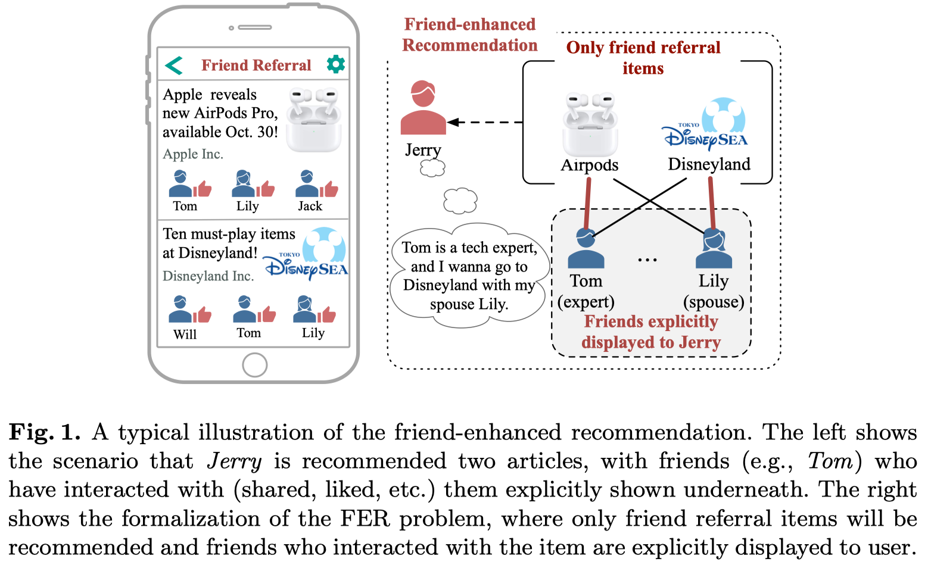
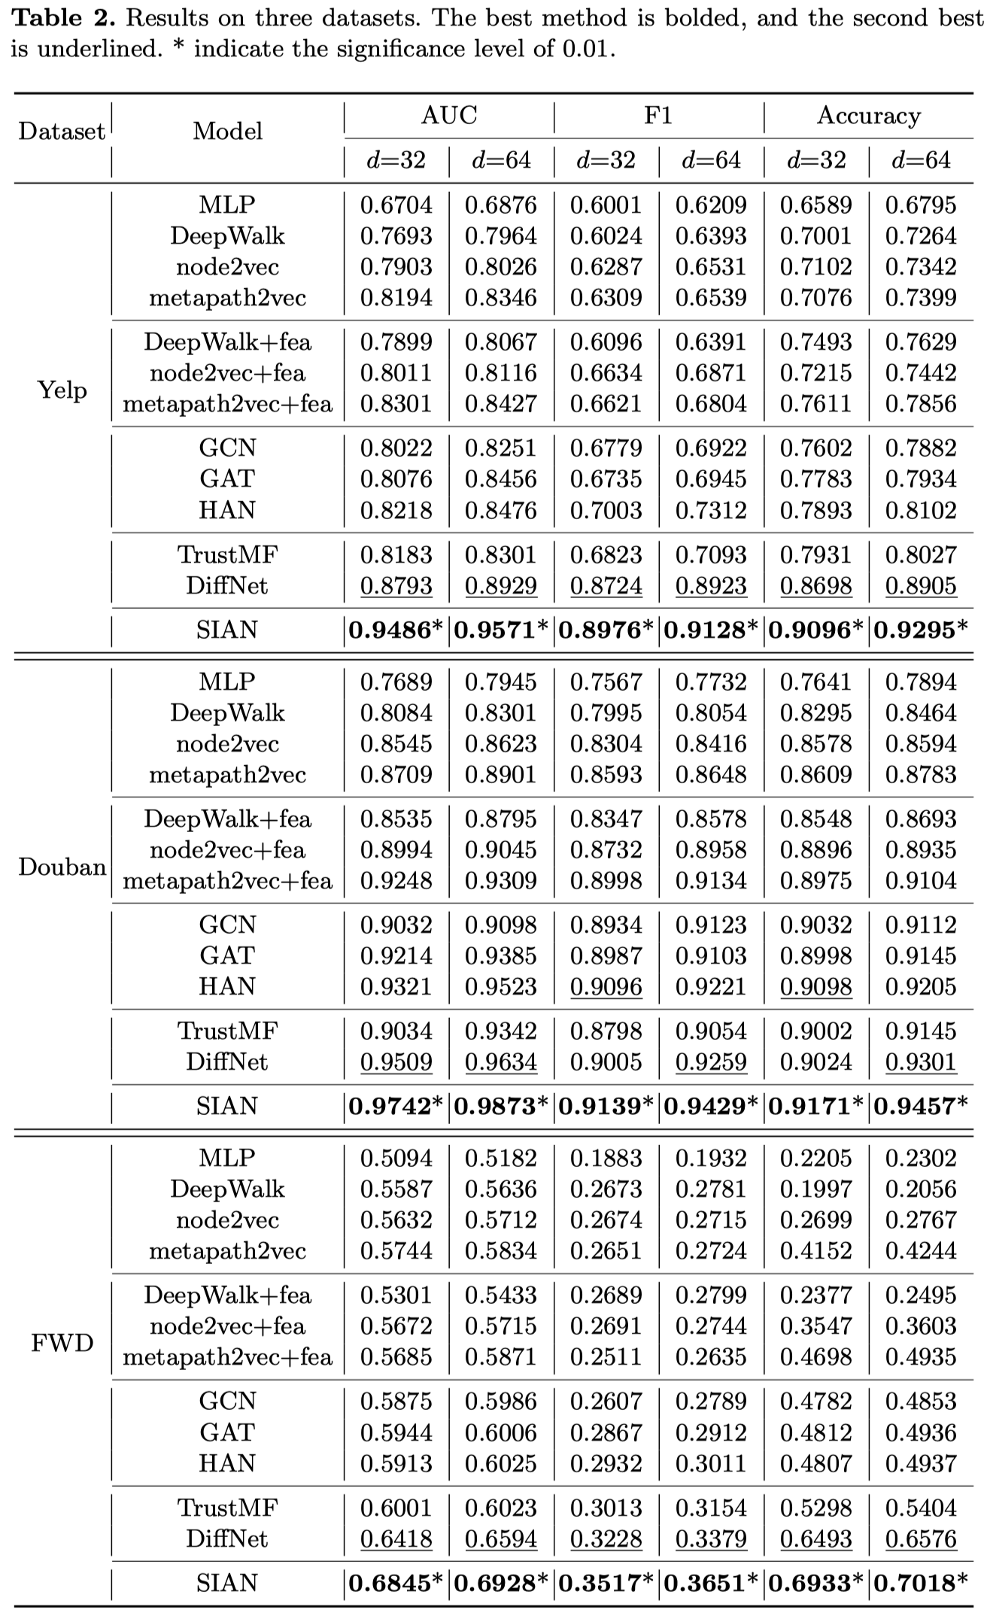
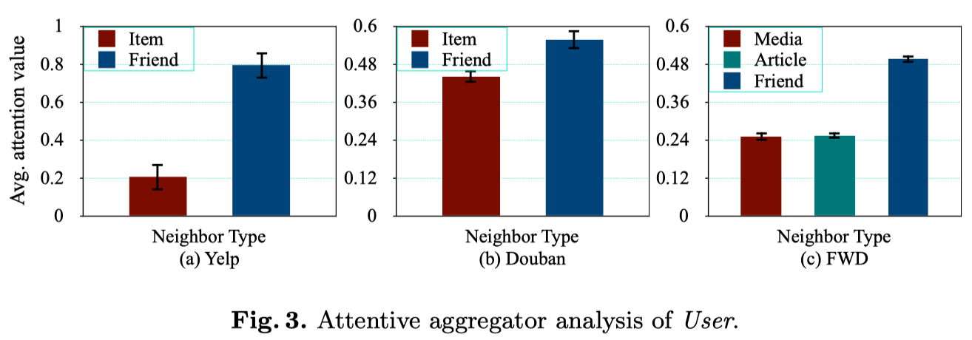
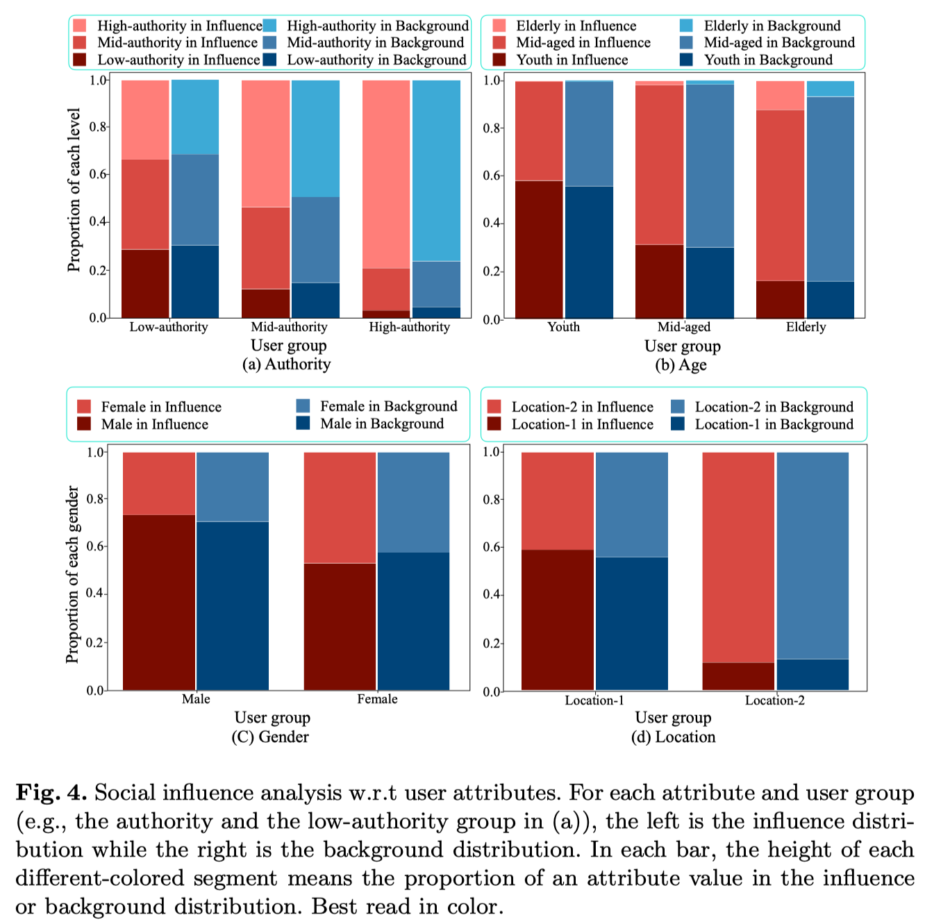
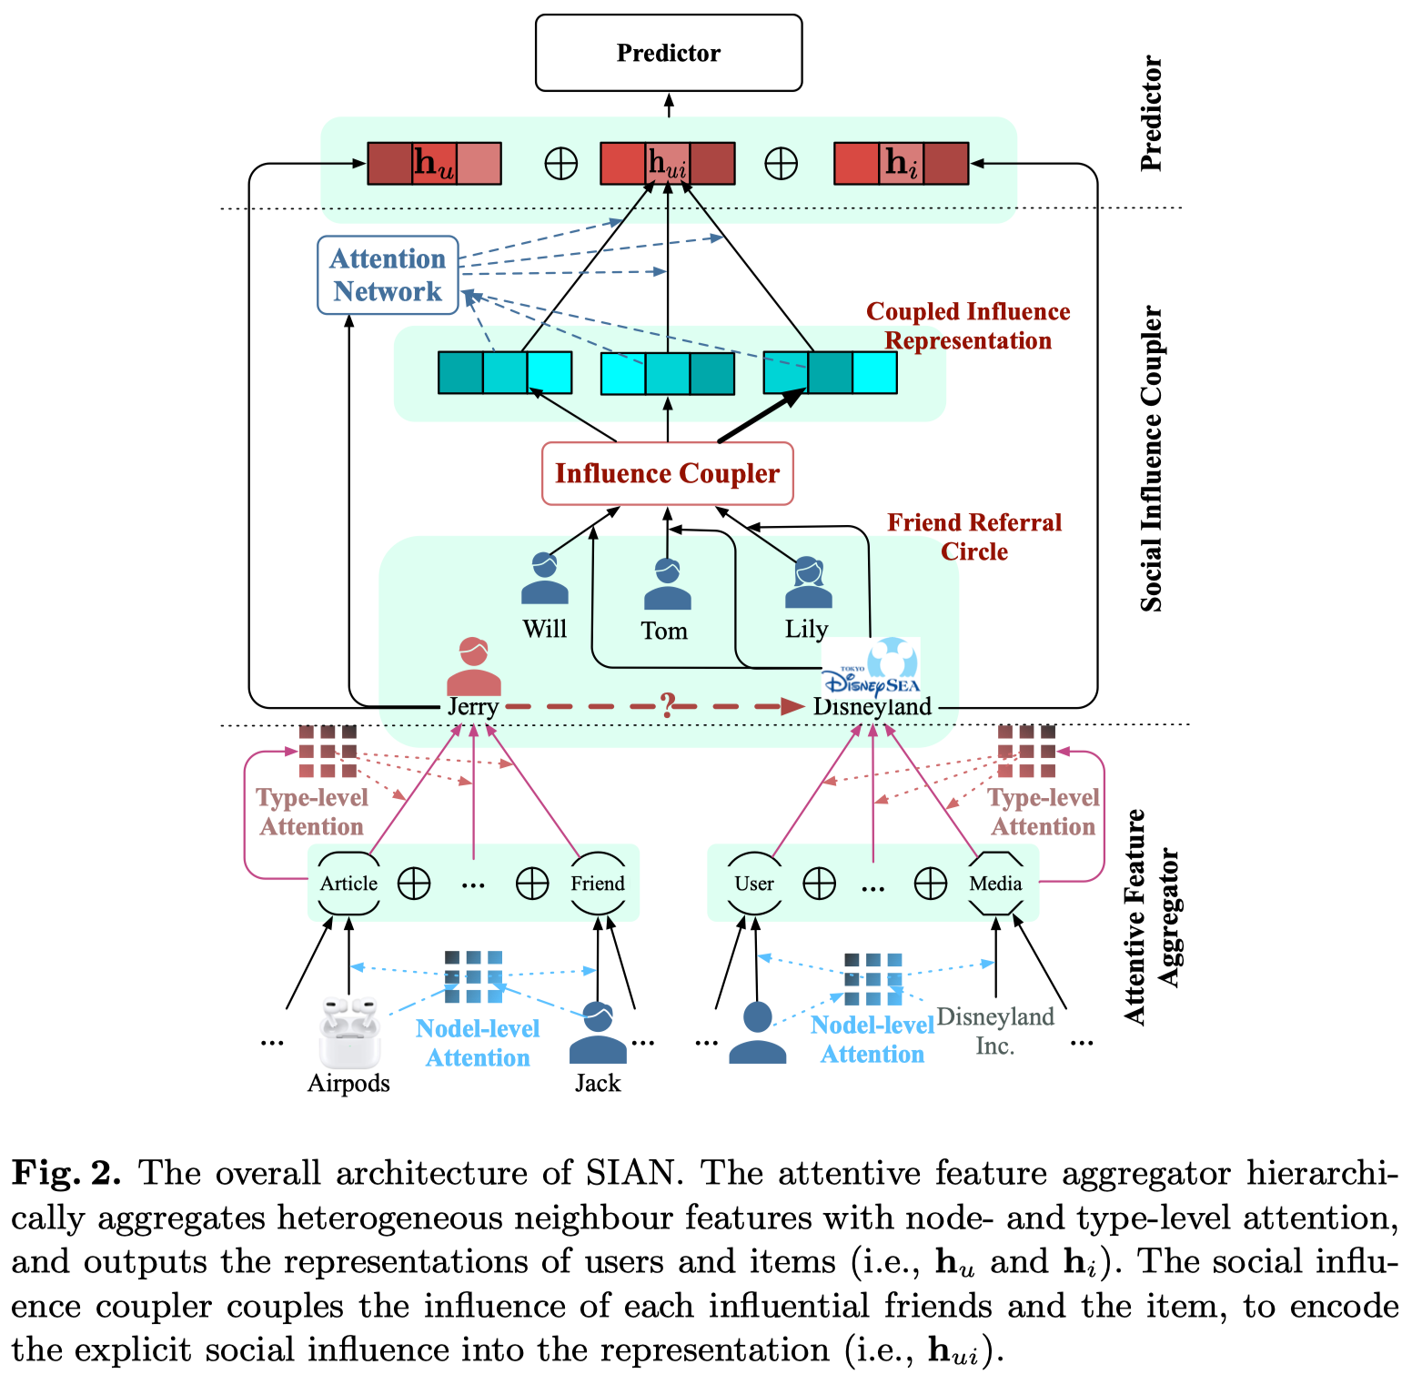
Overview
Friend-Enhanced Recommendation
Social Influence Attentive Neural Network

Slide 3
Outline
Motivation
SIAN
Experiments
Conclusions

Slide 4
Outline
Motivation
SIAN
Experiments
Conclusions

Slide 5
Motivation
People are more willing to actively express their opinions and share information with friends on social platforms
Friends become essential information sources and high-quality information ﬁlters.
…
Images from the Internet.

Slide 6
Friend-enhanced Rec.
Friend-enhanced Recommendation
Only recommends items that friends have interacted with
All friends who have interacted with the item are explicitly displayed to the user attached to the recommended item
Friend Referral Circle (FRC)
friend set having interacted with the item
FRC has even changed the recommendation paradigm compared to classical social recommendation

Slide 7
Friend-enhanced Rec.
The reasons for a user clicking an article may come from
interests in item contents (item)
the recommendation of an expert (item-friend combination)
the concerns on his friends themselves (friend).

Slide 8
Challenges
C1: How to extract key information from multifaceted heterogeneous factors?
FER involves multiple heterogeneous factors such as item contents, friend referrals and their interactions
C2: How to exploit explicit friend referral information?
The explicit friend referrals greatly emphasize the importance of social information in recommendation

Slide 9
Outline
Motivation
SIAN
Experiments
Conclusions

Slide 10
Overall Framework of SIAN
Social Inﬂuence Attentive Neural network (SIAN)
C2:
Social inﬂuence coupler to couple inﬂuence diﬀusing through the explicit friend referral circles
C1:
Attentive feature aggregator with both node- and type-level aggregations

Slide 11
Attentive Feature Aggregator
Node-level Attentive Aggregation
Type-level Attentive Aggregation

Slide 12
Social Influence Coupler
Coupled Influence Representation
Attentive Influence Degree

Slide 13
Behavior Prediction

Slide 14
Outline
Motivation
MetaHIN
Experiments
Conclusions

Slide 15
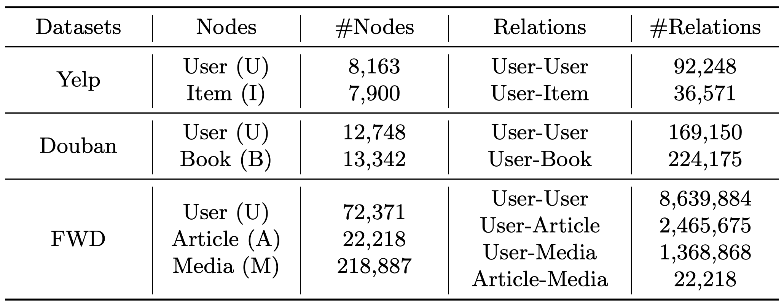
Experiments
3 datasets
4 types of baselines
feature/structure-based methods (MLP, DeepWalk, node2vec and metapath2vec)
fusion of feature/structure ({DeepWalk, node2vec, metapath2vec}+fea)
graph neural network methods (GCN, GAT and HAN)
social recommendation methods (TrustMF and DiﬀNet).

Slide 16
Experimental Results
SIAN outperforms all baselines in all metrics on three datasets
Type-level attentive aggregation is not limited by the predeﬁned meta-paths used in previous methods
Friend referral factor may take the dominating position in FER

Slide 17
Impacts of Multifaceted Info.
The average attention value of the Friend type is significantly larger than 0 that other types.
It is perhaps astonishing that the model pays more attention to users’ social relationships.
This also justiﬁes the proposed social inﬂuence coupler in SIAN, which plays an important role in extracting preferences from FRCs.

Slide 18
Analysis on Social Inﬂuence
User behaviors are more inﬂuenced by their friends who are more authoritative, regardless of what authority the user him/herself has
Users are easy to be inﬂuenced by their friends which are similar to themselves (similar age/location/gender).

Slide 19
Parameters Analysis
the optimal performance is obtained near λ = 0.0005,
λ cannot be set too small or too large to prevent overfitting and underfitting.

Slide 20
Outline
Motivation
SIAN
Experiments
Conclusions

Slide 21
Conclusions
A novel friend-enhanced recommendation problem and a social inﬂuence attentive neural network (SIAN).
SIAN learns user and item representations with a two-level attentive aggregator and distills preferences from the unique friend referral circles with a social influence coupler.
Experimental results demonstrate that SIAN significantly outperforms state-of-the-art baselines, and reveal interesting sociological patterns.

Slide 22
Q&A
Thank you !
Q&A
More materials in
https://yuanfulu.github.io
http://shichuan.org
http://www.yfang.site

